Slide 1

Loan Approval Status Classification
Ahmad Saladin
https://github.com/Saladin21/loan-approval-classification

Slide 2
Dataset
Classify loan approval status (approved or rejected) based on features.
Dataset is collected from Kaggle: https://www.kaggle.com/datasets/taweilo/loan-approval-classification-data/data
The dataset contains 45,000 records and 14 variables

Slide 3
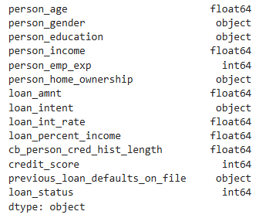
Data Types

Slide 4
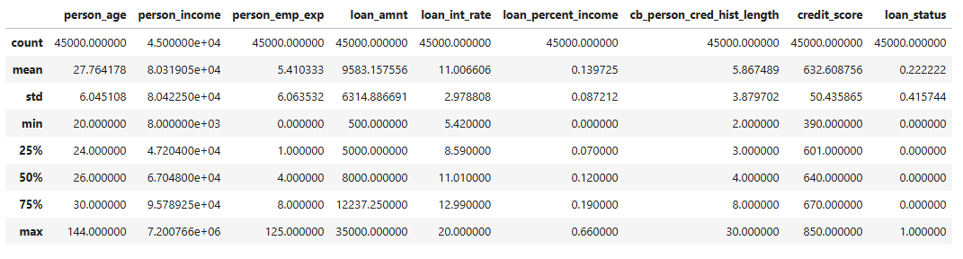
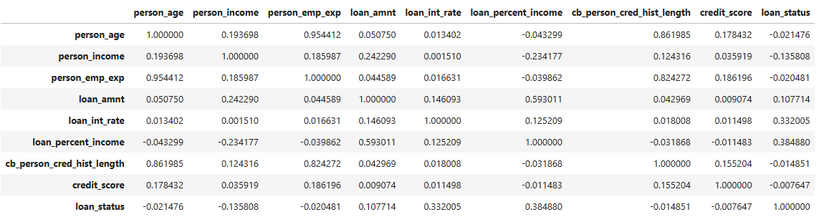
Numeric Data

Slide 5
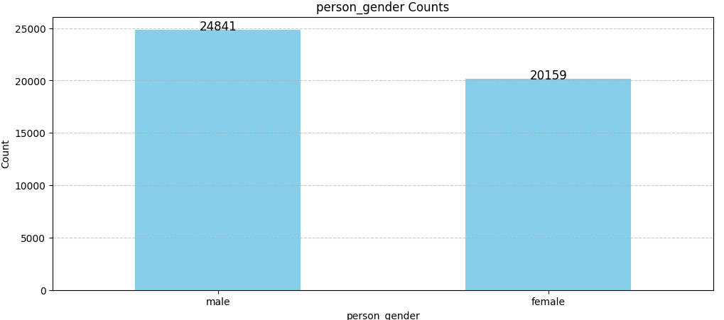
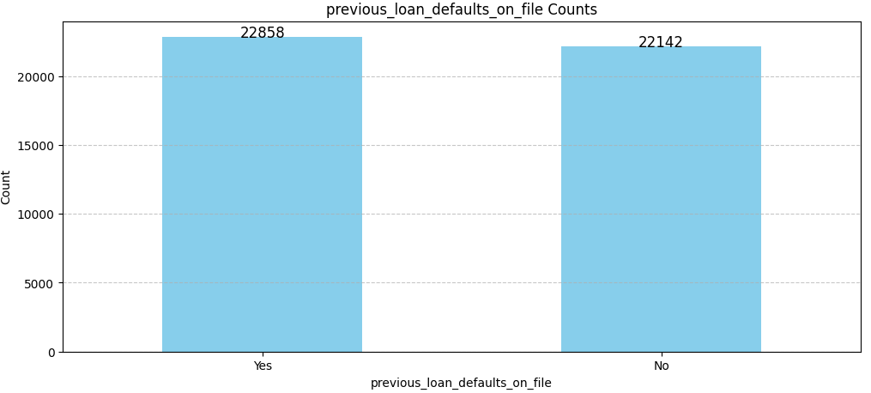
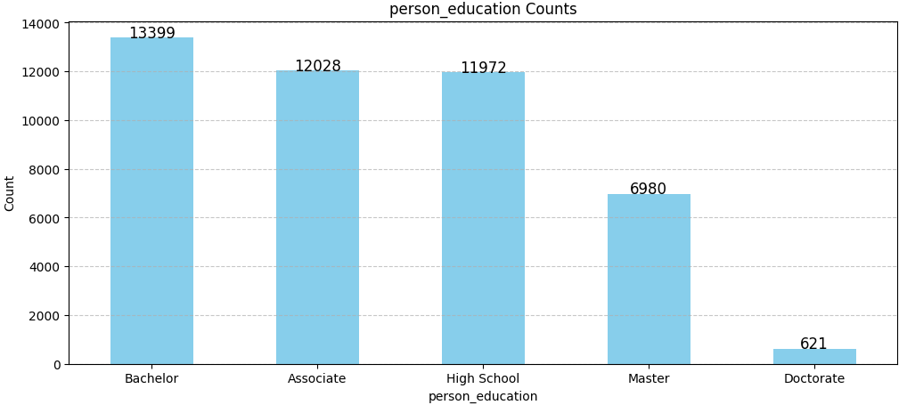
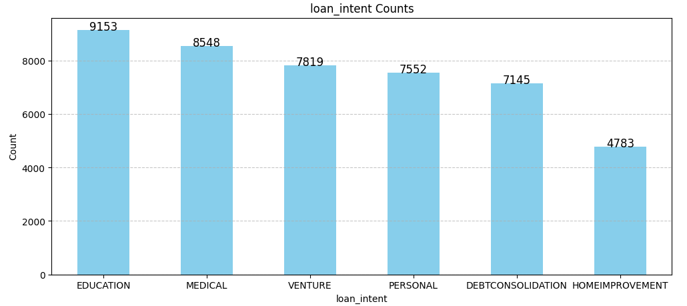
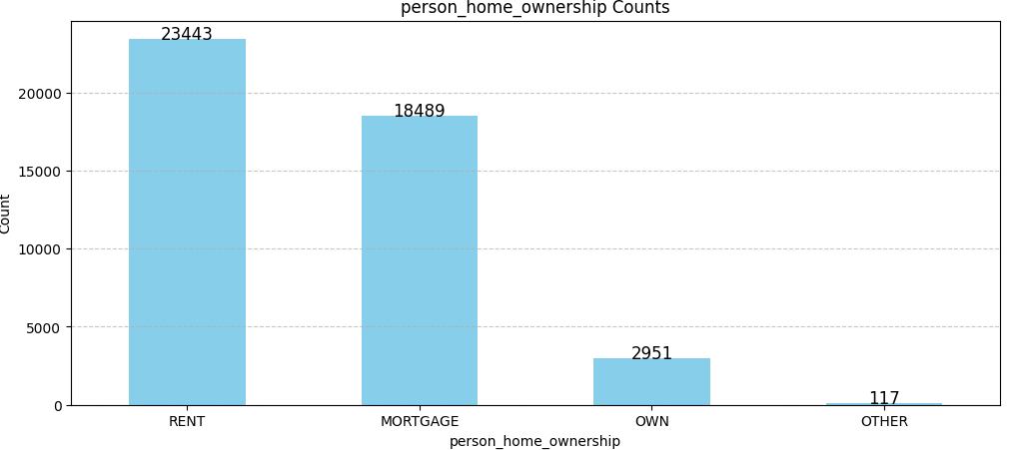
Non-Numeric Data
Notes:
For Non numeric data I created bar charts with the counts of each values for the features. With this chart we can also see the unique values available for each features.

Slide 6
Encoding of Non Numeric Data
Non-numeric data is encoded with pandas categorical or OneHotEncoder.
Categorical is used for data that have inherent order.
person_gender : OneHotEncoder
person_education : Categorical
person_home_ownership : OneHotEncoder
loan_intent : OneHotEncoder
previous_loan_defaults_on_file : categorical
Notes:
For Analysis Non numeric data will be encoded using pandas categorical or one hot encoder. Categorical encoding is used for data that have inherent order, in this case person_education and person_loan_defaults_on_file. The rest use one hot encoder

Slide 7
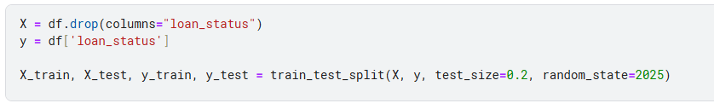
Train-Test Split
Data is split into 80% train, and 20% test using sklearn train_test_split
Notes:
For Analysis the data is split into 80% train, and 20% test using sklearn train_test_split

Slide 8
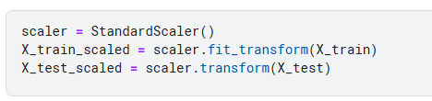
Data Scaling
Some methods such as Logistic Regression might benefit from scaling.
Scaling using StandardScaler
Notes:
Some methods such as Logistic Regression might benefit from scaling, so I create two set of data scaled and not-scaled

Slide 9
Training Strategy
Split Data : 80% train, 20% test
Train Logistic Regression, Decision Tree, Random Forest, AdaBoost, XGBoost using 5-fold cross-validation using AUC metric
SVM is not used because of the high number of samples, SVM has high complexity for number of samples.
Perform Grid Search on best performing model
Evaluate on Test Set
Notes:
The training strategy used for the analysis is that first I split the data into 80% train and 20% test. And then using several ML methods I fit the data using 5-fold-cross-validation with AUC metric. The methods used are logreg etc. SVM is not used because the high number of samples makes it perform pretty slow due to the complexity for number of samples. After that the method with highest AUC is selected and further finetuning of hyperparameter is done using grid search. Lastly the resulting model will be evaluated on the test set.

Slide 10
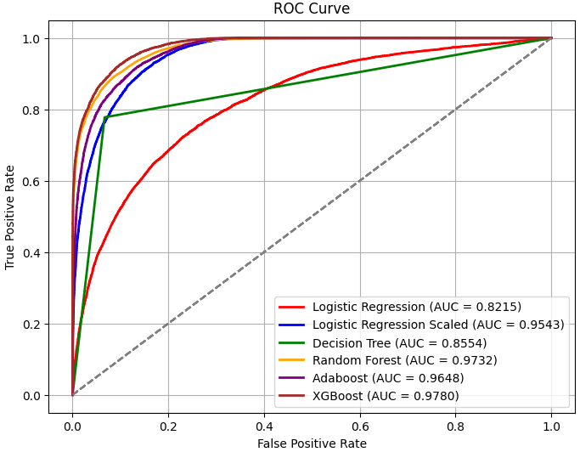
Different Model Results
Notes:
Here are the AUC results of the 5-fold cross validation. From the plot we can see that XGBoost has the best AUC.

Slide 11
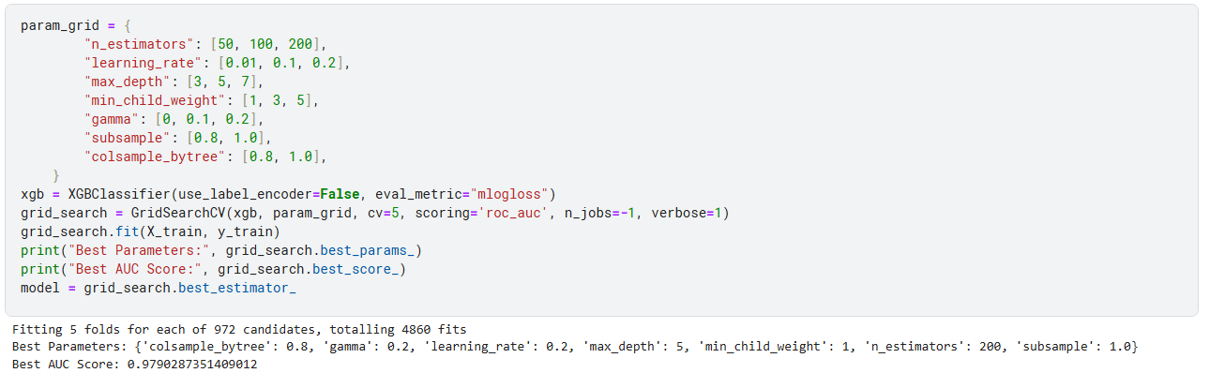
Grid Search on XGBoost
Notes:
Based on the Plot before, XGBoost is selected and further hyperparameter tuning is done using gridsearch. The parameters tuned can be seen in the param_grid and the best parameters are … . The best AUC Score found is 0.979 which is a slight improvement from the one in previous slide

Slide 12
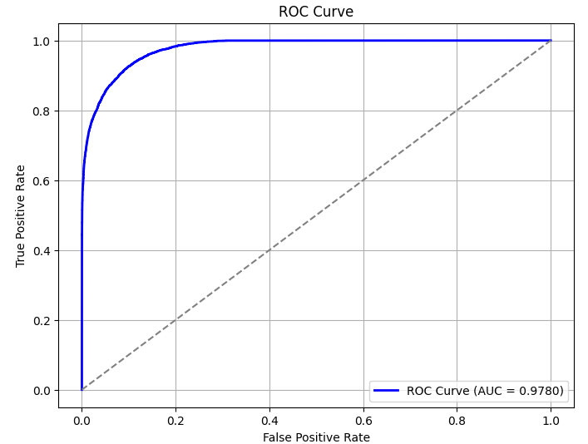
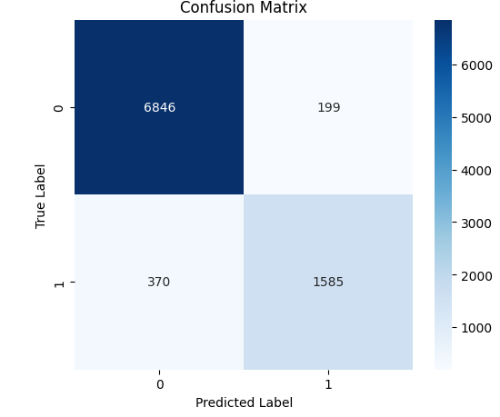
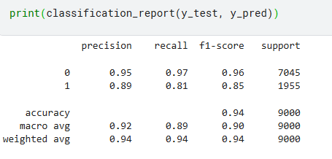
Conclusion
Notes:
The best XGBoost model from the gridsearch is evaluated on the test set and here is the result. The AUC score is 0.97 which is similar with the AUC from the training set. From the confusion matrix we can see that it correctly classify most of the data, with 1585 Tp, 6846 TN, 199 FP, and 370 FN. The accuracy of the prediction is 0.94. Overral this model performs well for the task of classifying Loan approval status, however the f1-score for class 1 is lower than class ) this might be caused by imbalance in the data where we have higher number of sample with class 1. Further improvement for the model migh be done with sampling methods to address this issue. That is all for me, thank you for your attention.

